Slide 1
Project Title Customer Retention
Presentation by
Akshay Shingavi

Slide 2
Summary
Introduction​
Exploratory Data Analysis(EDA)
Column wise data analysis
Comparison with target column
Correlation of dataset set using heatmap
Correlation of all features with targe column(bar)
Conclusion

Slide 3
Introduction
Customer retention is the collection of activities a business uses to increase the number of repeat customers and to increase the profitability of each existing customer.
It has emerged as one of the most important factors that guarantee the success of online store; it has been posited as a key stimulant of purchase, repurchase intentions and customer loyalty. A comprehensive review of the literature, theories and models have been carried out to propose the models for customer activation and customer retention. Using the Data analytics skills we are going to analysis the given dataset to understand major factors that contributed to the success of an e-commerce store which is also matching as said in the above theory.

Slide 4
Exploratory Data Analysis(EDA)
Column wise data analysis

Slide 5
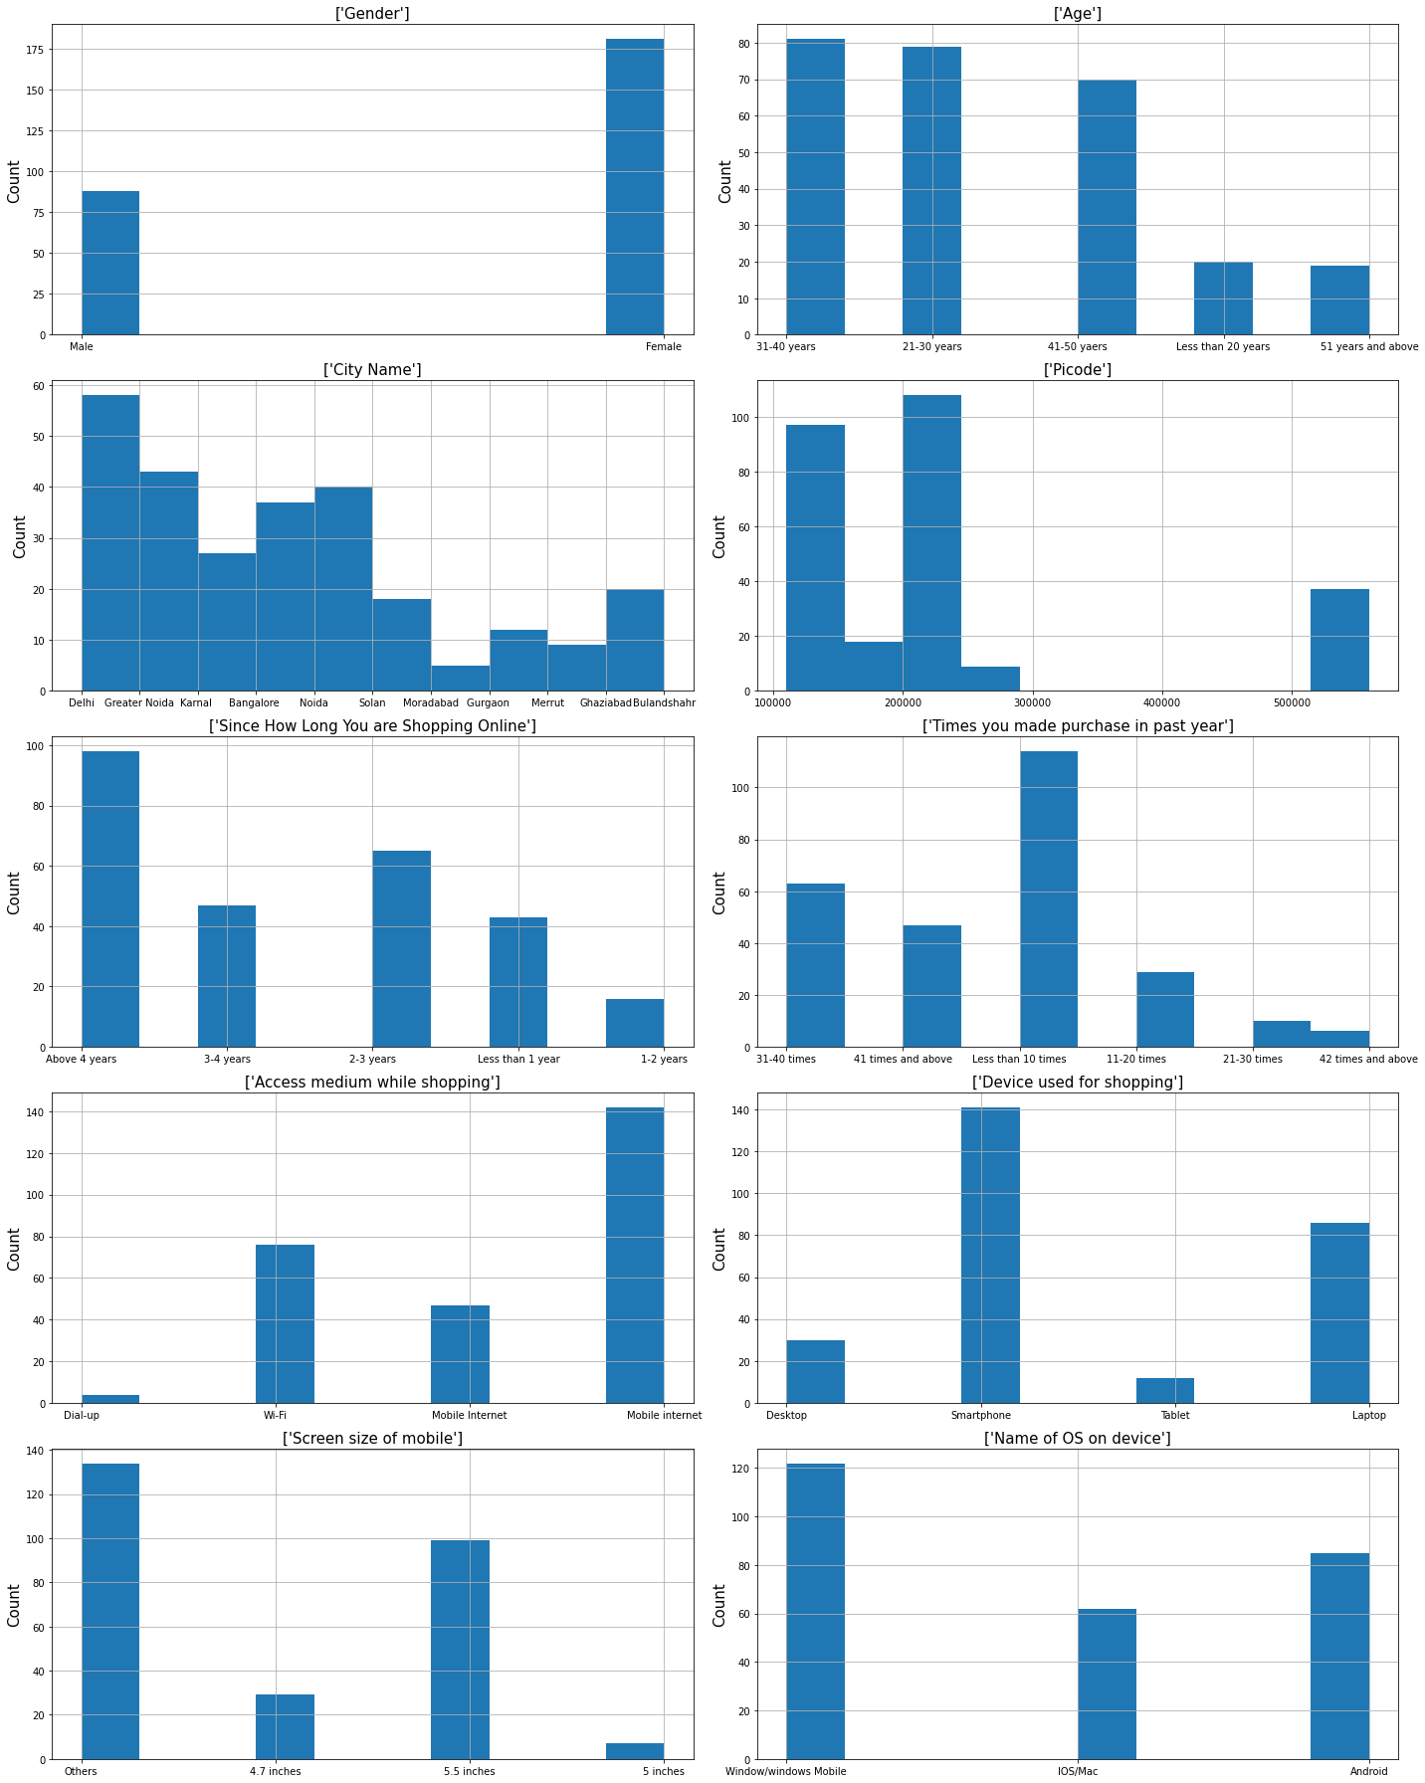
Observations 1. Majority of the age group is between 21-30 years and 31-40 years, there is little difference in this age category. In which female customers are more than male customers. 2. Observed that most of the online shopping is done in Delhi. 3. Most of the people are shopping since last 4 years. 4. Mainly shopping is done via mobile using mobile internet.

Slide 6
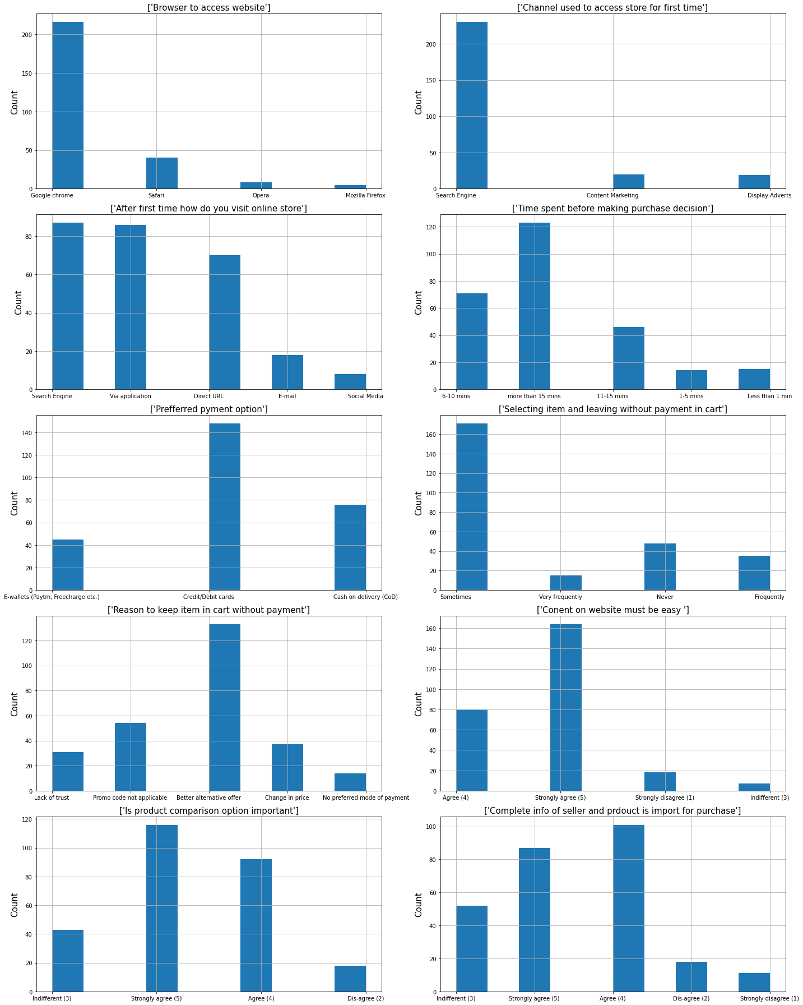
Observations 1. It’s been observed that first time customers visit these sites via search engine and mainly from google chrome, other web browsers are no way near. 2. From next time most of the people get tuned to application, however same amount of people also prefers using search engine to visit the site. 3. On an average approx. More than 15 mins are spent by the customers on these sites. 4. Most payments are done by credit cards followed by COD and e-wallets respectively.

Slide 7
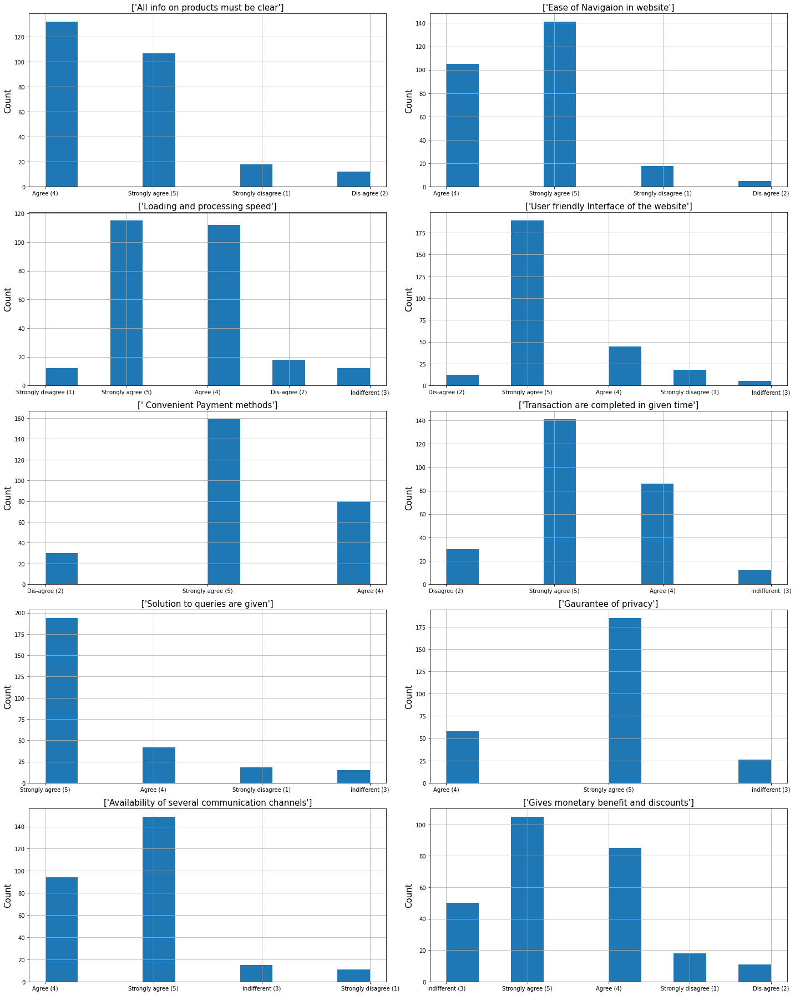
Observations 1. Mostly people have agreed that these websites give ease to navigate the product on website and are user friendly. 2. There is ease in make payments as payment mentioned are very convenient. 3. Also, solution to any query is given in specified time, customers also agree upon that their privacy is safe. 4. Due to available of several communication channels it becomes easy to communicate which helps in smoothing customer journey.

Slide 8
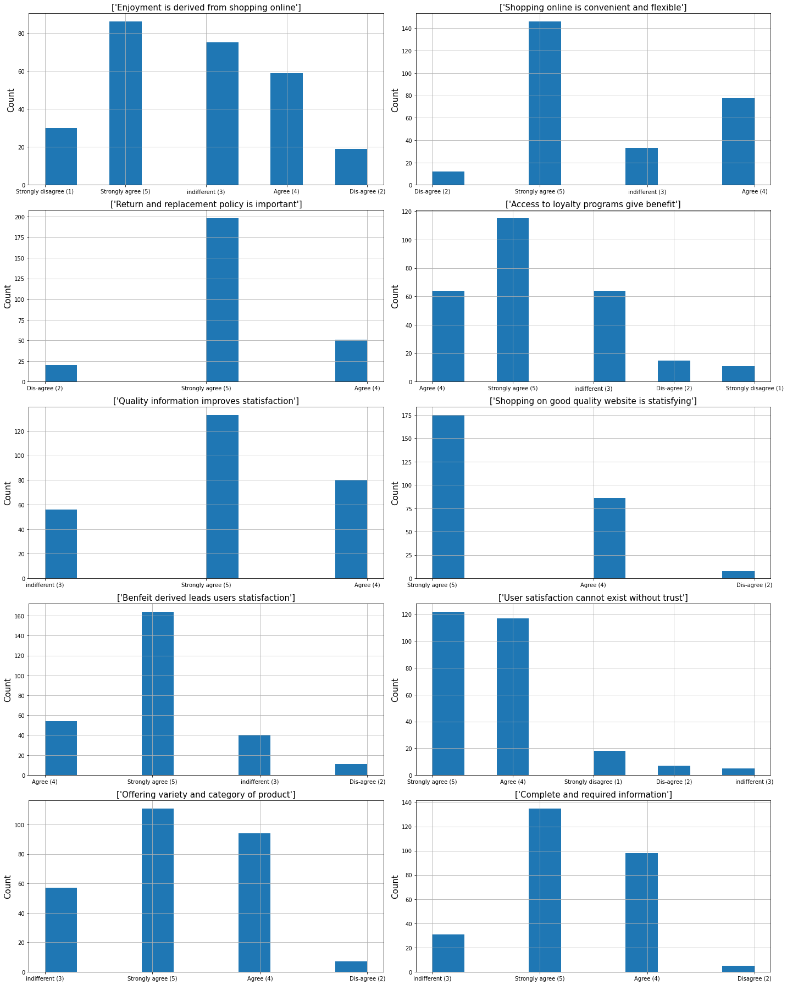
Observations 1. Lots of customers agree that online shopping is easy, flexible and convenient, where there is not much positive ratio in enjoyment of online shopping as it has mixed reviews from customers. 2. According to most of the customers, return and replacement policy of the company is very important along quality of information improves satisfaction of the customers as its gives convenience of shopping online. 3. Most of people also agree that quality, variety, complete information of product and trust are import for the customer to revisit these sites.

Slide 9
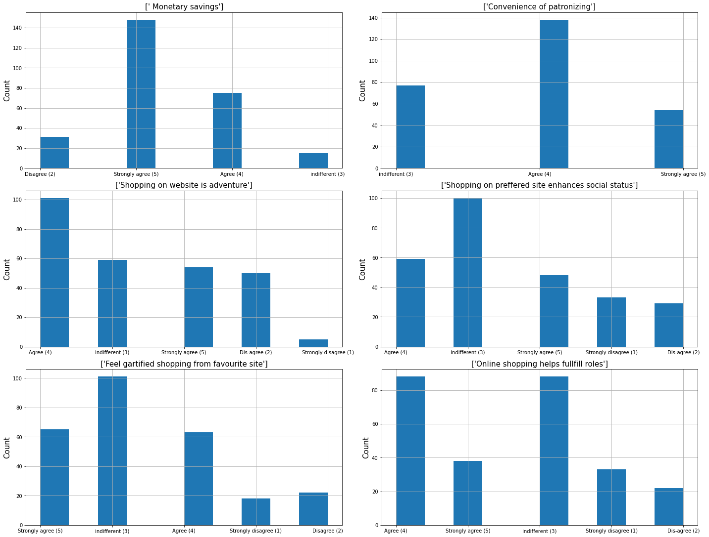
Observations 1. Most of the customers agrees that they have saved money while shopping online. 2. While most of the customer preferred to be patronized, but large amount of them are also not sure about this. 3. Also, there are mixed reviews of customer if they feel adventure in shopping. 4. Many people are not sure if online shopping affects their social status. 5. Most of the people are confused or not sure if they are gratified from favorite site. 6. According to most of the customers online shopping helps fulling roles.

Slide 10
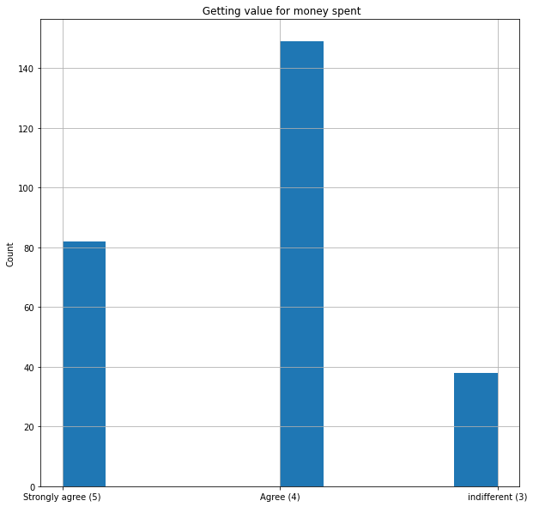
Value for money spent
Sr No | Getting value for money spent | Number of Customers
1 | Agree (4) | 149
2 | Strongly agree (5) | 82
3 | indifferent (3) | 38

Slide 11
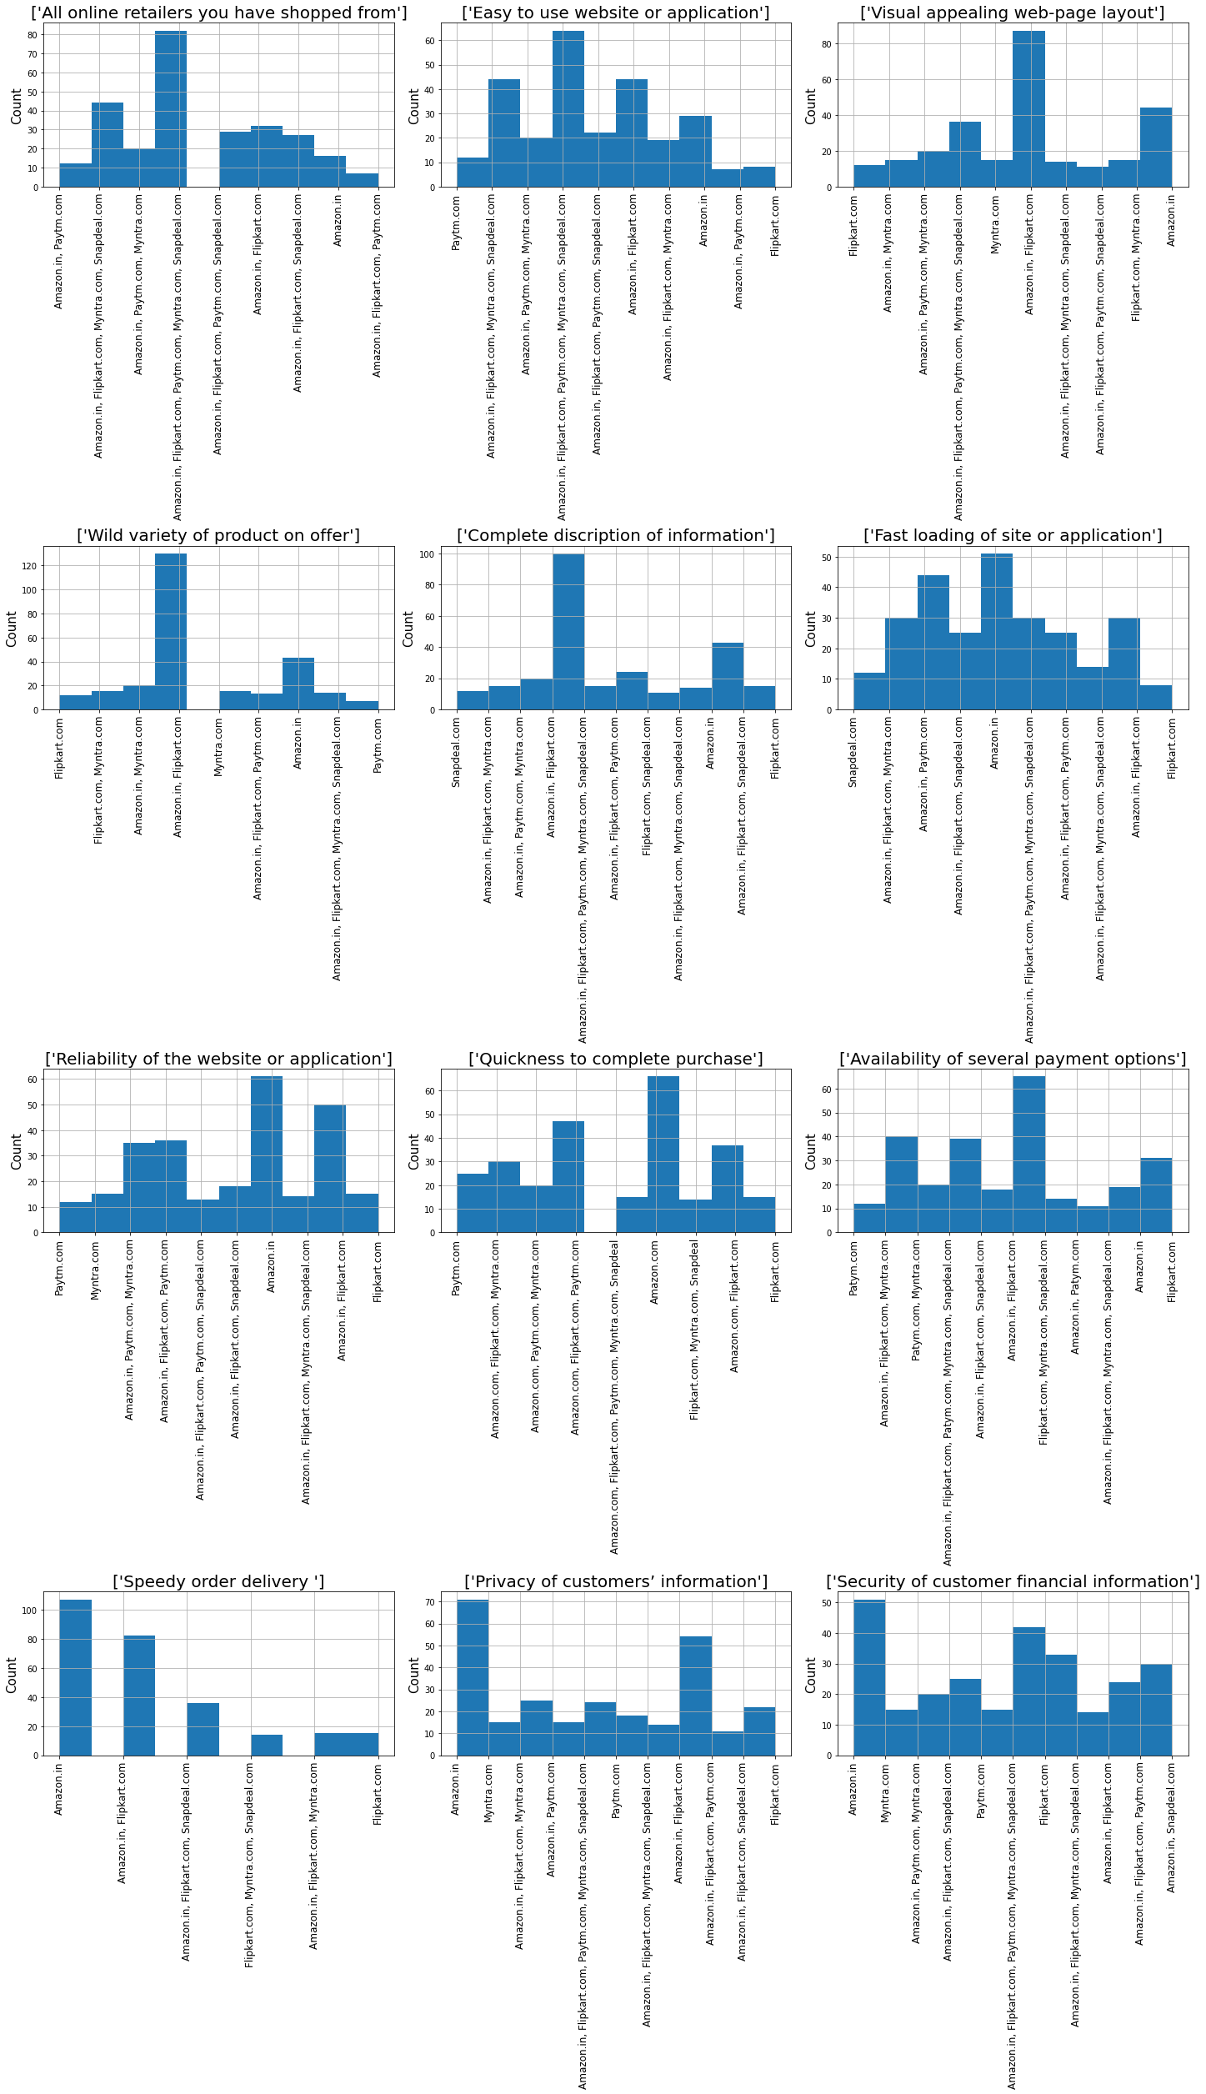
Observations 1. Above data states that every has shopped from amazon n at least one time. 2. Most people also have voted for amazon for being easy to use site followed by flipkart. They both are also good in page layout or visual effects along with variety of products which they provide. 3. These two also provide proper description of products as well. 4. Many positive votes are in favor of amazon, its on top number in providing delivery on time followed by flipkart and Snapdeal. 5. Customers have also voted highest to amazon for data privacy and keeping their financial information secured.

Slide 12
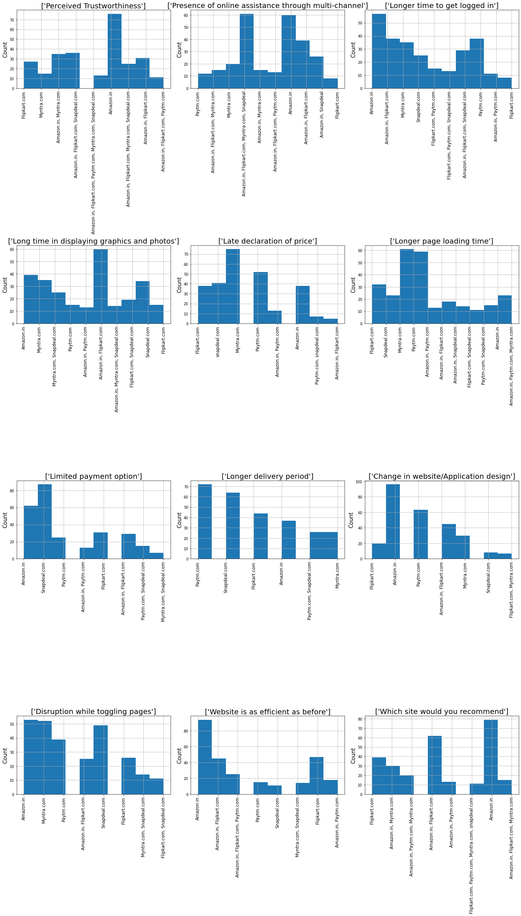
Observations 1. Amazon have gained their customer’s trust; it also provides support via multiple channels to their customers. 2. Many people have also voted that that on amazon they get longer time to be logged in, followed by flipkart and paytm. 3. Also, flipkart and amazon are slow in loading graphic along with page information. 4. It’s observed the Myntra shows delay in displaying price, also it takes longer time to load the page, its same for the paytm. 5. Snapdeal has the lowest payment method followed by amazon. 6. Paytm followed by Snapdeal takes longer time to deliver the products. 7. Many people have voted that they would recommend amazon due to its speed, service, ease etc.

Slide 13
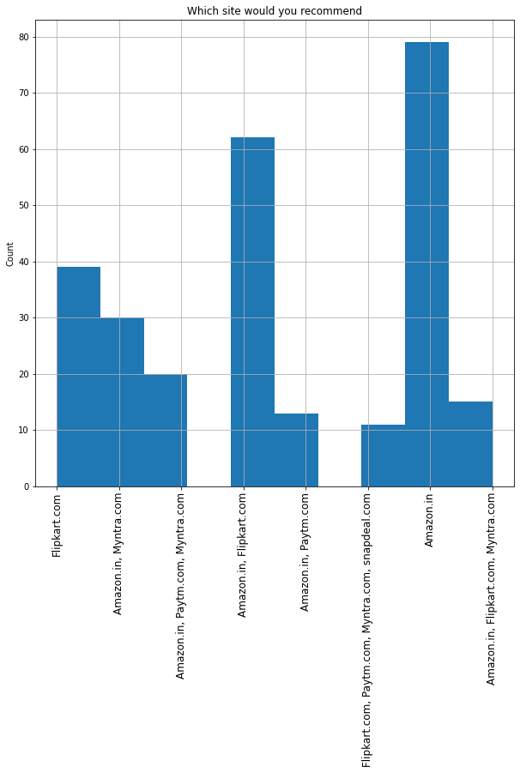
Most recommended site
Sr No | Which site would you recommend | Number of Customers
1 | Amazon.in | 79
2 | Amazon.in, Flipkart.com | 62
3 | Amazon.in, Flipkart.com, Myntra.com | 15
4 | Amazon.in, Myntra.com | 30
5 | Amazon.in, Paytm.com | 13
6 | Amazon.in, Paytm.com, Myntra.com | 20
7 | Flipkart.com | 39
8 | Flipkart.com, Paytm.com, Myntra.com, snapdeal.com | 11

Slide 14
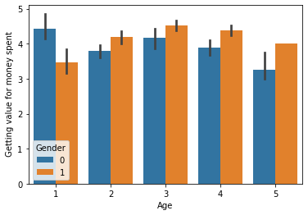
Most recommended site (Gender and age wise)
Age
1 = Less than 20,
2 = 21-30 Years,
3 = 31-40 Years,
4 = 41 - 50 Years,
5 = 51 Years and above
Gender
0 = Male
1 = Female
Females are more satisfied by the value for money spent in all other categories except where age is less than 20 years.

Slide 15
Exploratory Data Analysis(EDA)
Comparison with target column

Slide 16
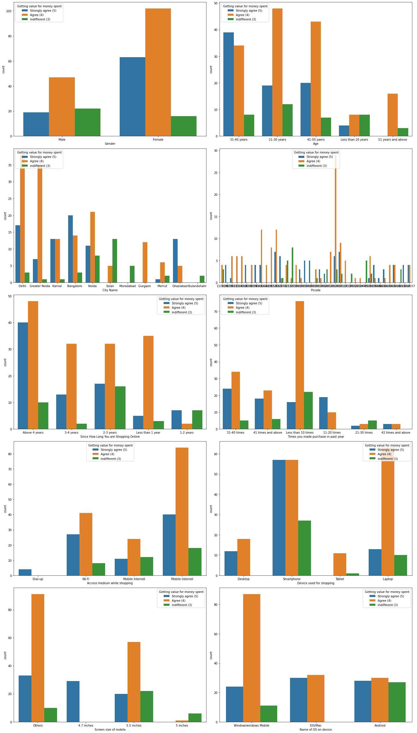
Observations 1. As per above graph there are more female customers than male and females are mor, they have agreed that they are getting true value for the money they have sent. 2. Age category of 21-30 are more as compared to 31-40, however there is not much difference in their feed most of the people have agreed that they are getting value for the money spent. 3. Customers from Delhi and Greater Noida have agreed upon the same, but customers from solan and Moradabad and Bulandshahr don’t agree with this. 4. The ratio of customers which are shopping since long agree but customers who are shopping for 1-2 years have poor ratio. 5. Customer who shops for less than 10 times have poor ratio of happy customer, however as the number gets increasing the ratio of happy customers getting increasing. 6. Smart phone users are happier in this case as compared with ratio of other users.

Slide 17
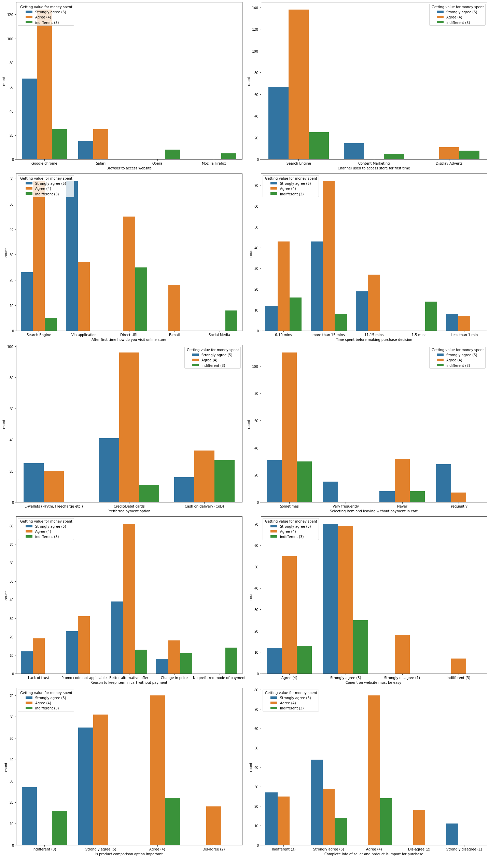
Observations 1. People using chrome have agreed that they are getting true value for money, however customers using opera and Mozilla fire fox seems to be dissatisfied as there is no customer agree to the value for money sent. 2. Customers who spent more than 15 minutes before shopping are satisfied that they are getting true value for money where as in another scenario the ratio gets depraved. 3. There are more agreeing credit card customers however the ration gets bad where people who have selected COD.

Slide 18
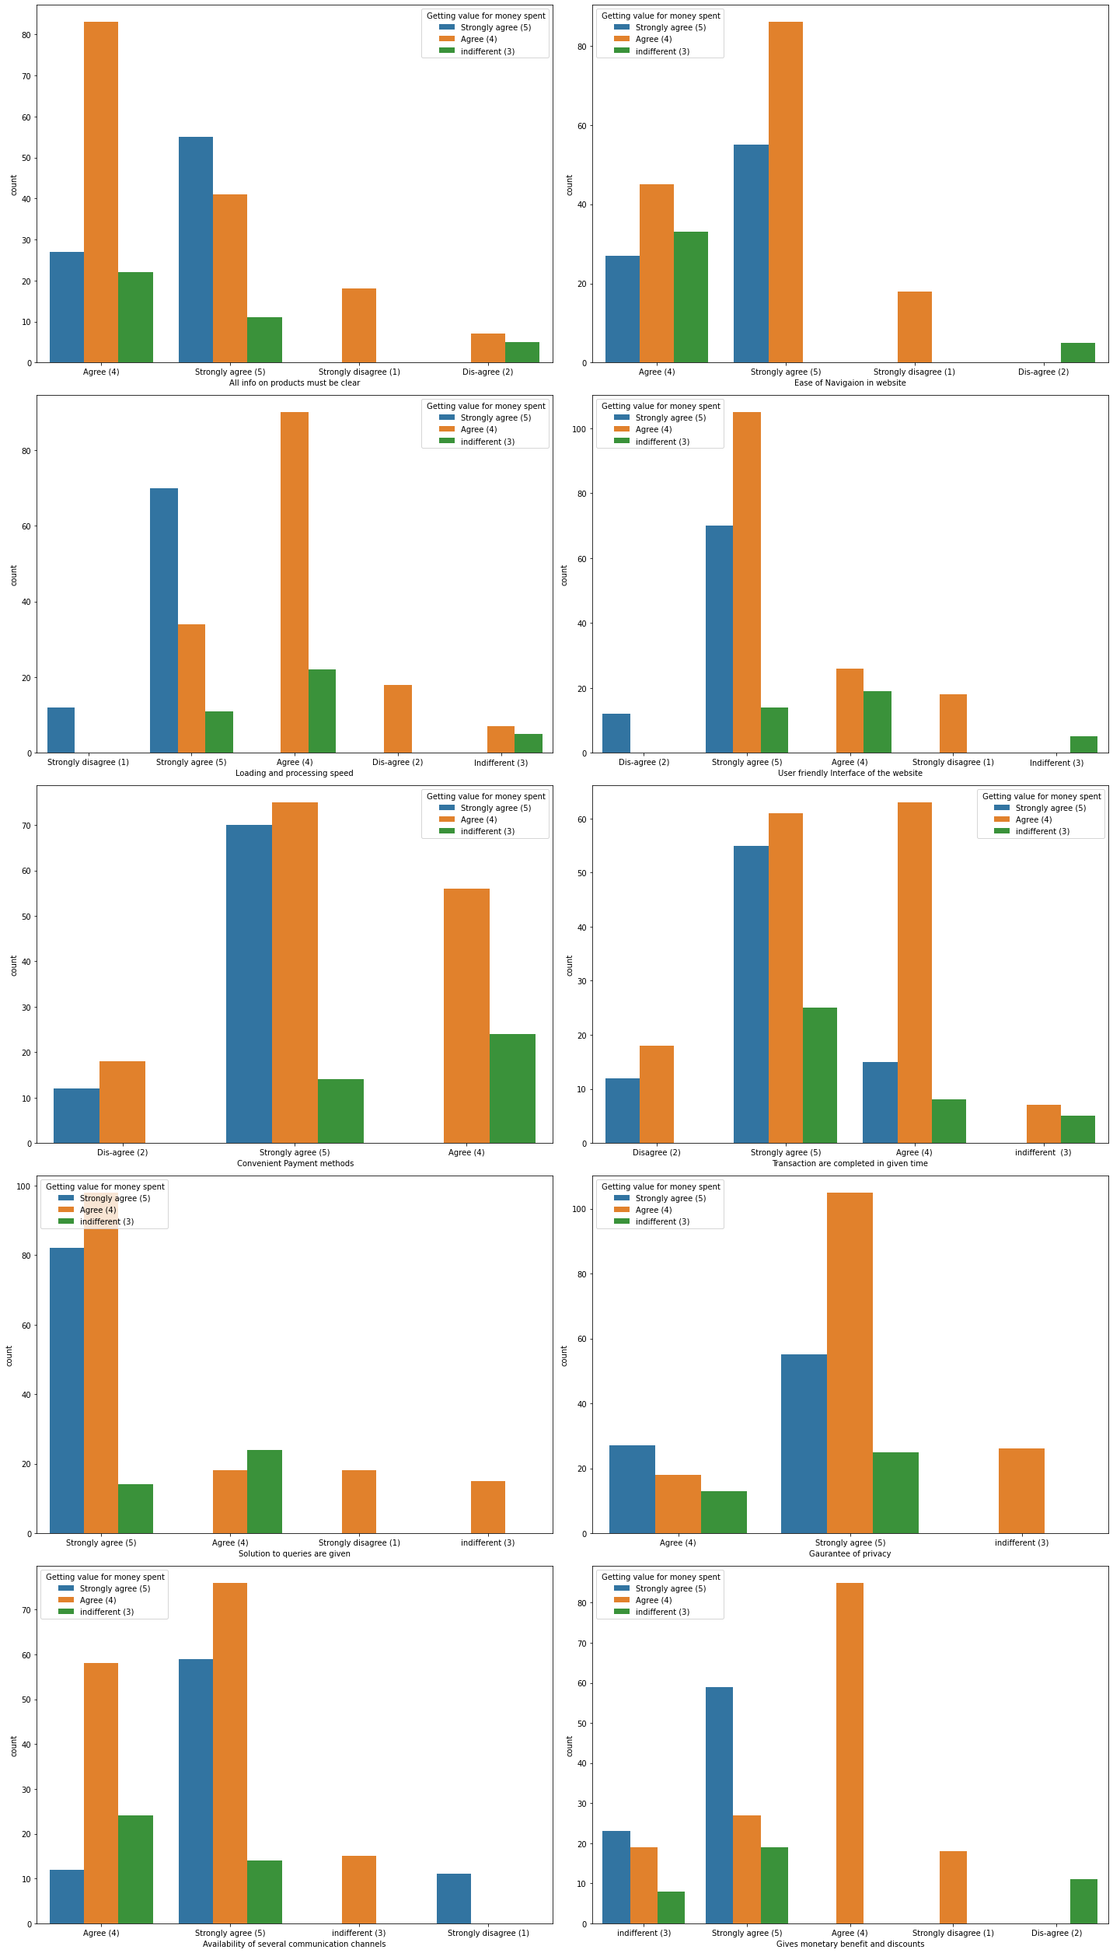
Observations 1. The customer who thinks websites has convenient method of payments are happy and agree that they are getting true value for the money they spent. 2. Where solution to the customers query is answered they seem to be happier and here the strongly agree with the value for money spent. 3. Same with the data privacy, it is also related to the value for money spent, it gives positive indication to the customers. 4. The person who gets more discounts seems to be happier and agreeing. 5. Availability of several communication medium to the customers also gives pleasure to the customer which helps in getting positive response.

Slide 19
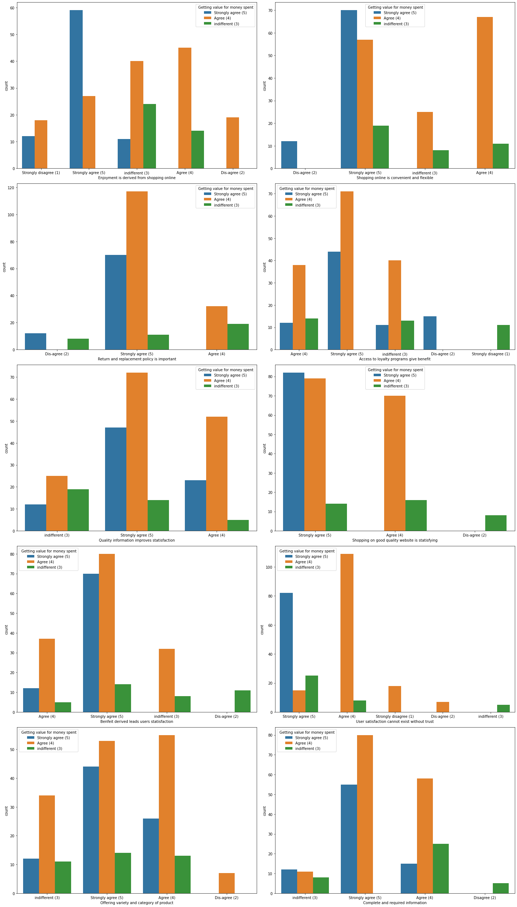
Observations 1. Most people strongly agree where they enjoy shopping online. 2. Also, value of money is derived from convivence and flexibility provided in online shopping, here people agree that they are getting true value for their money. 3. Trust and satisfaction also increase the chance of happy customers, here strong result is derived, most of the feel happy and agree upon this. 4. Complete and quality information provided will also increase result of happy customers, in this case customers agree.

Slide 20
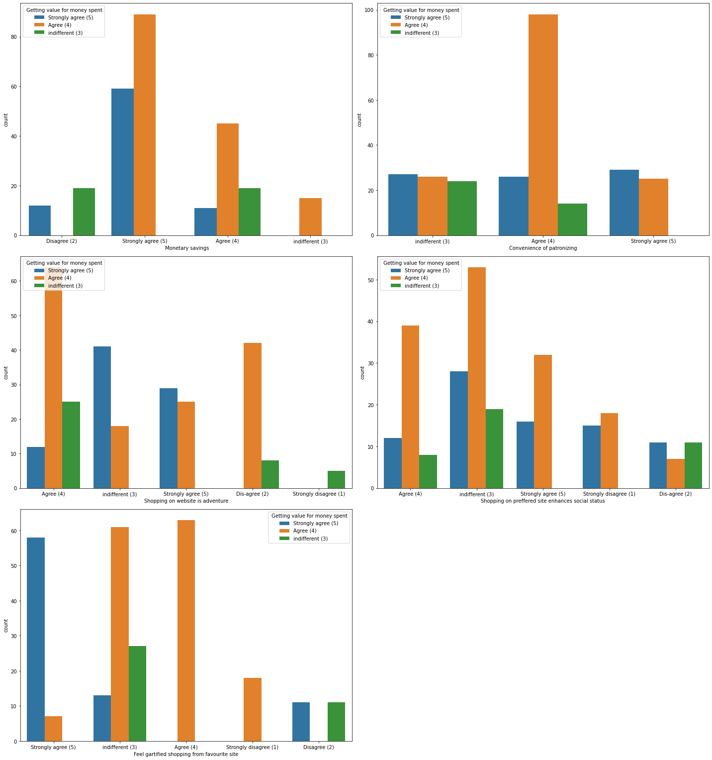
Observations 1. Most of the people agree that they are getting value for money spent where they derive monetary savings and feel gratified shopping from their favorite site. 2. Where shopping online enhance social status is not much related to value for money. Most people not agree with this, here the ratio becomes poor. 3. Convince of patronizing is also not the factor which have much import on value for money. Here the ratio is similar. 4. Overall, we can confirm that all the factors are not directly related to value for money which we have missed. However, there are some features which are directly related to the satisfaction of the customers which convince customer that they are getting value for the money paid.

Slide 21
Exploratory Data Analysis(EDA)
Correlation of dataset set using heatmap

Slide 22
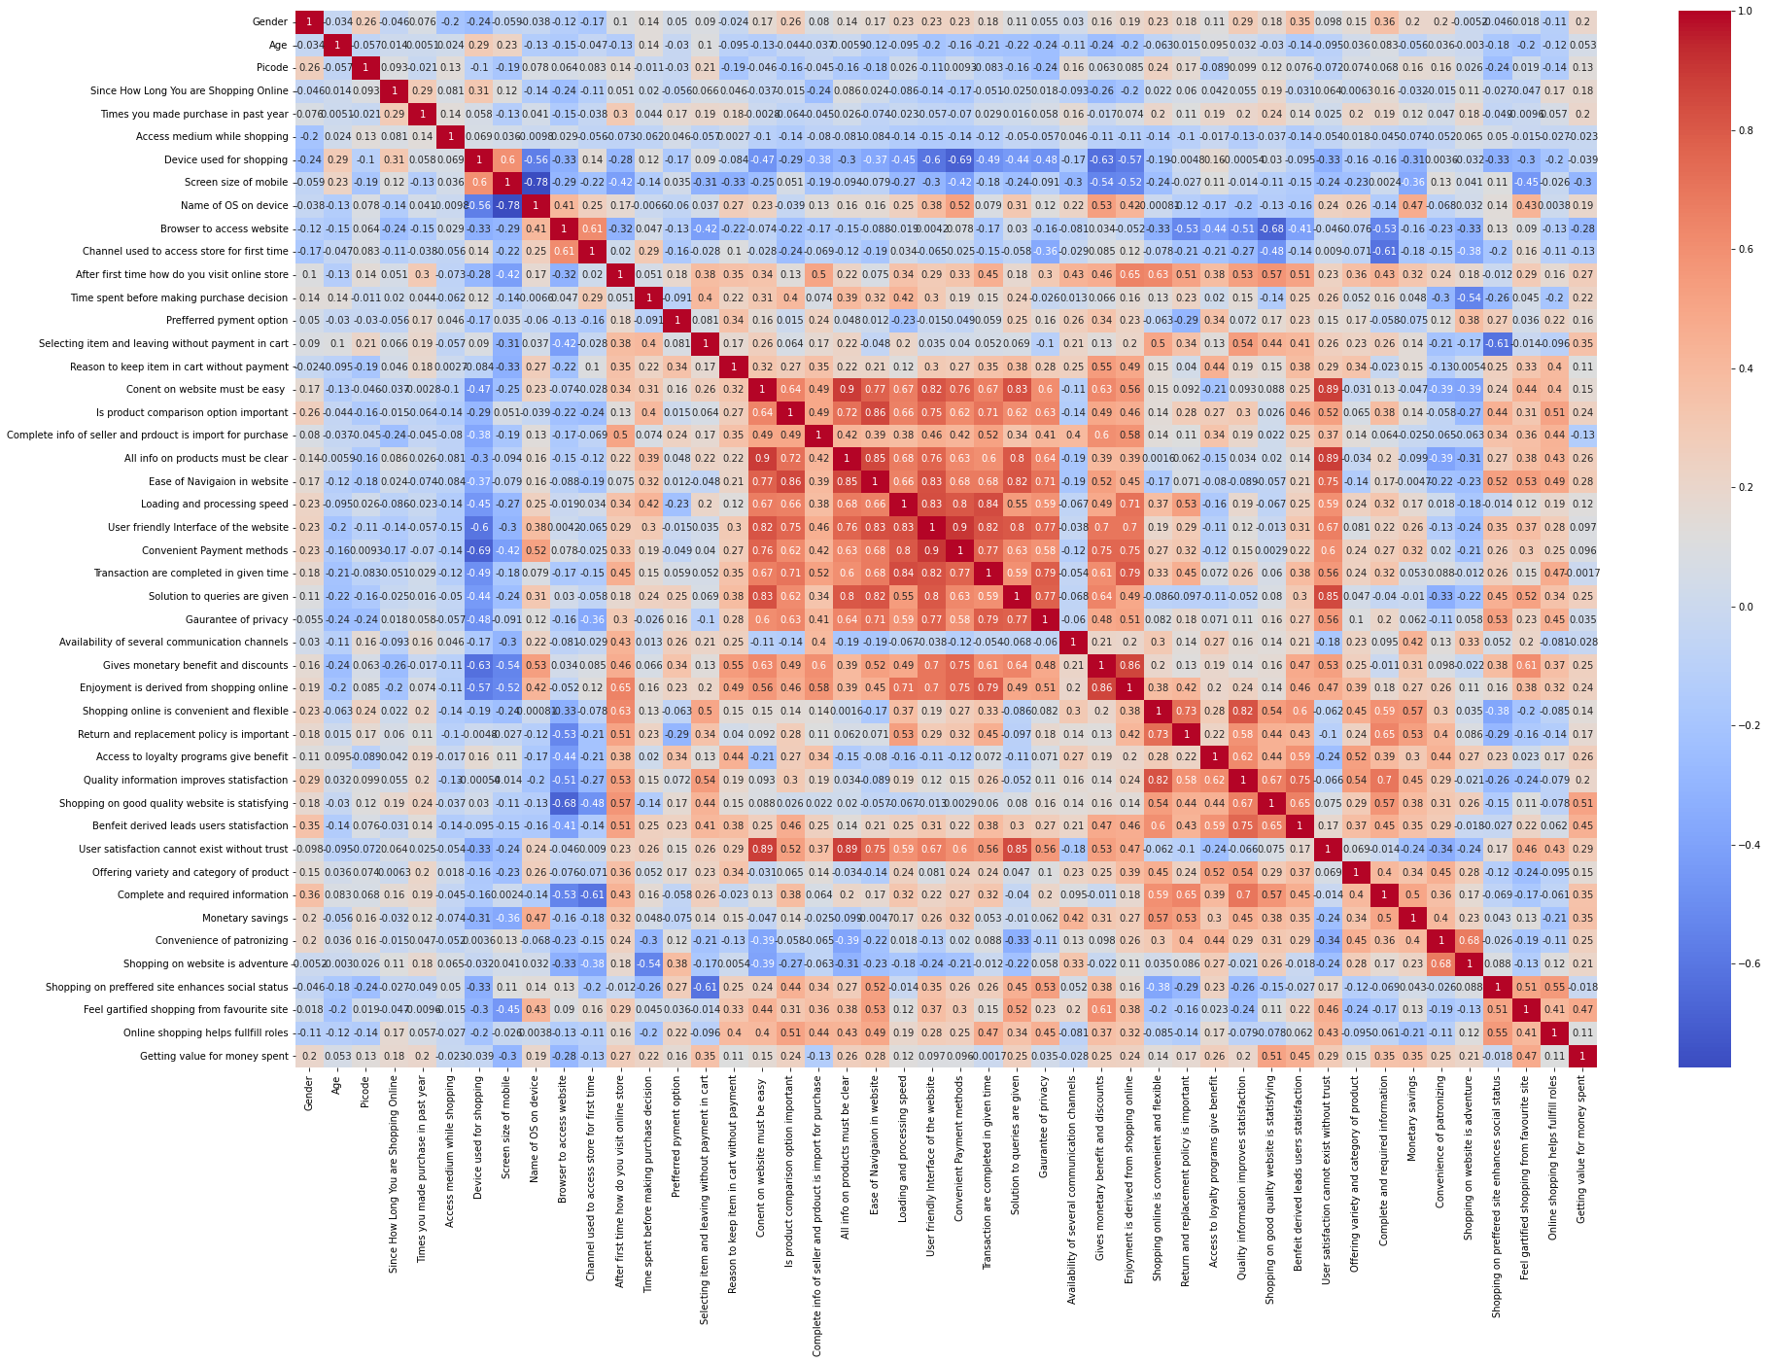
Heatmap of all features.

Slide 23
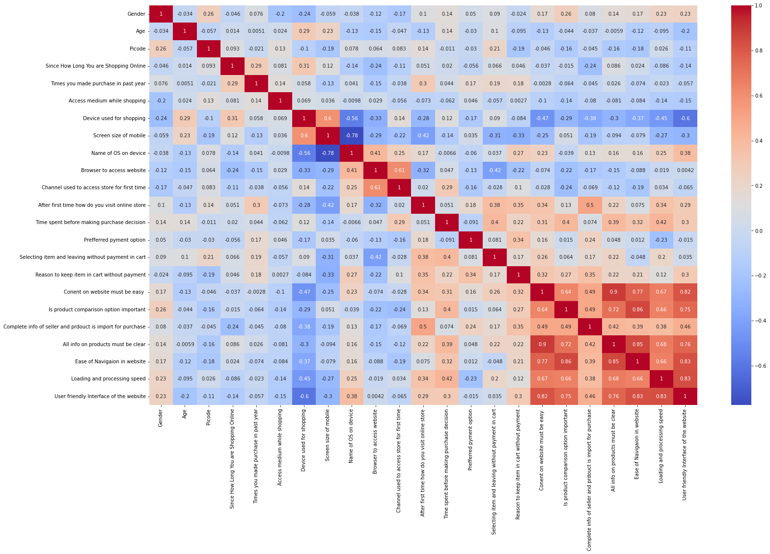
As pervious map was bit congested so divided it further into 2 part for more clear correlation. There is correlation of features with each other, which states where is relation between columns.

Slide 24
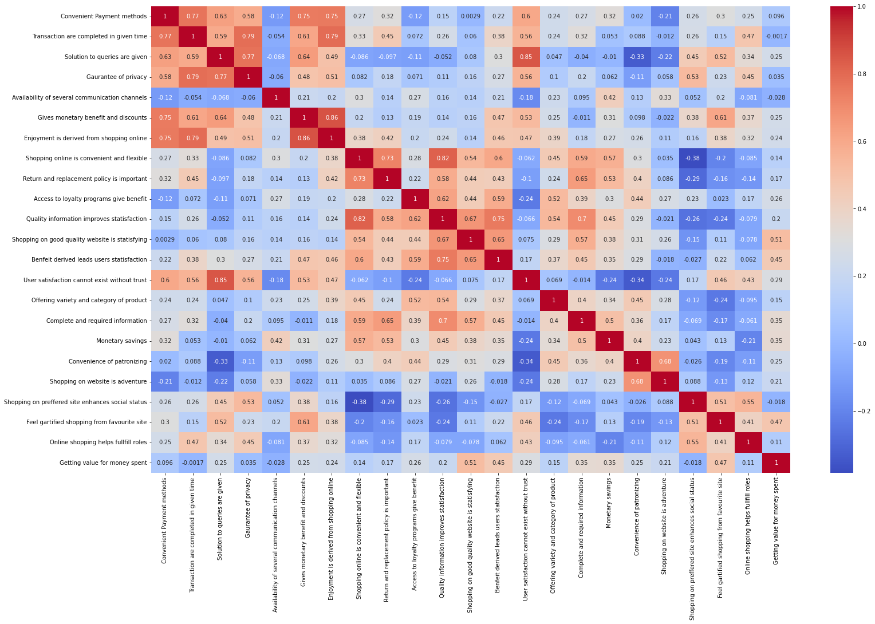
This is second part of our heatmap states correlation of columns with each other.

Slide 25
Exploratory Data Analysis(EDA)
Correlation of all features with targe column(bar)

Slide 26
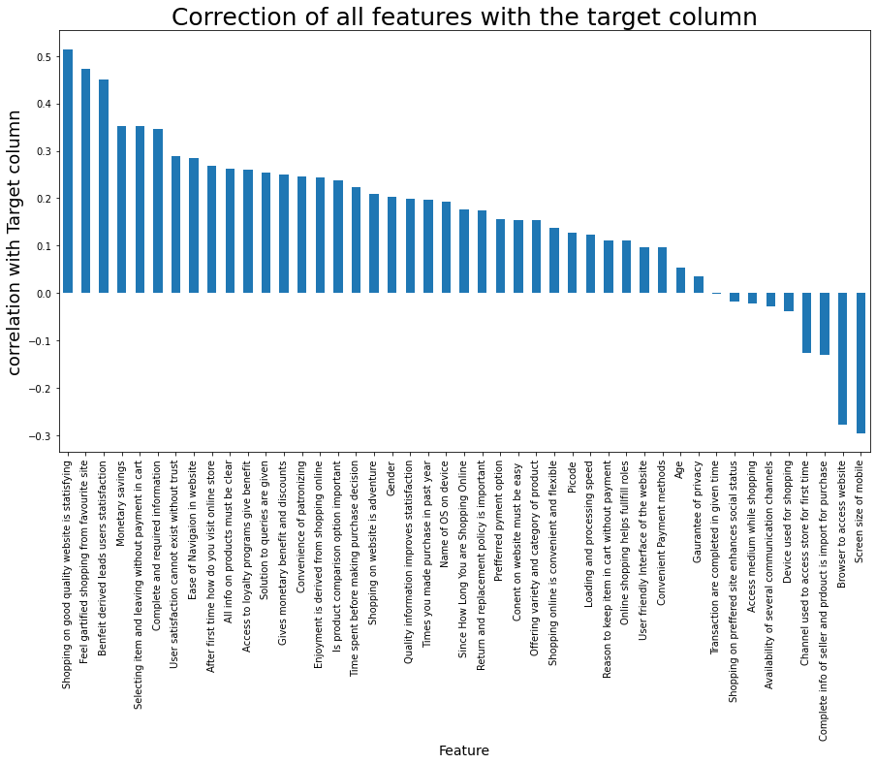
Final observation
All other columns are in positive relation to getting value for money spent however there are some exceptions which I have mentioned below. Below factor does not have any effect on value of money. Guarantee of privacy, Transaction are completed in given time , Shopping on preferred site enhances social status, Access medium while shopping, Availability of several communication channels, Device used for shopping, Channel used to access store for first time , Complete info of seller and product is import for purchase , Browser to access website and Screen size of mobile

Slide 27
Conclusion
The ease of usage of internet and these websites along with quality, attractiveness of the web pages and websites along with other proper and arrange customer support makes a customer to be a repeated user of these sites. It is also observed that shopping on good quality of website have the most positive feedback for the customer along with this discount and multiple payment options also attracts the customer attention along with other factors.

Slide 28
THANK YOU
Akshay Shingavi

